Slide 1
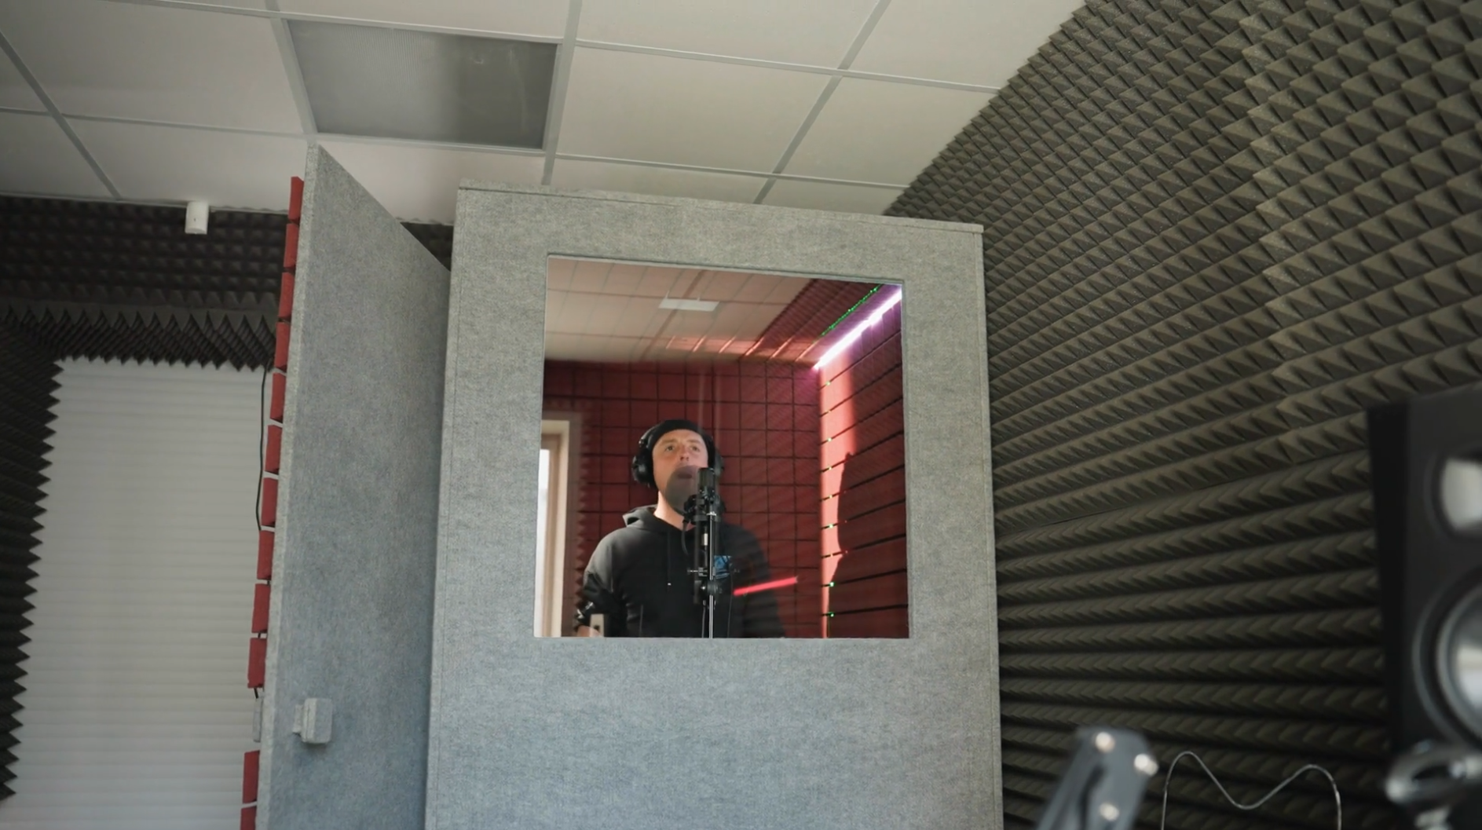
Acoustic Enclosures
Wall assemblies and enclosures
Tyler Dare

Slide 2
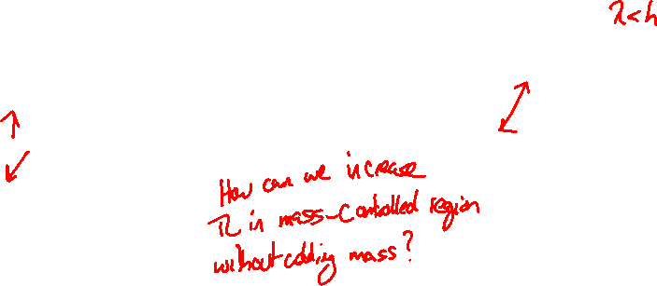
Transmission loss is very complicated

Slide 3

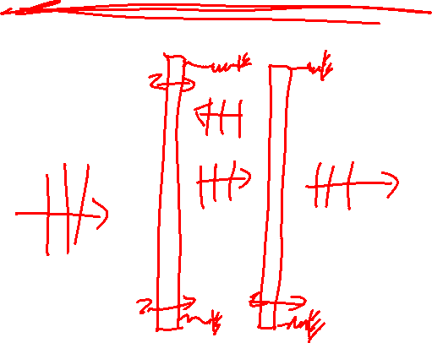
Multi-layer panels
Multiple panels separated by air can have a large effect on transmission loss.
XXX examples of wall constructions

Slide 4
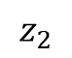
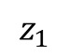
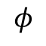
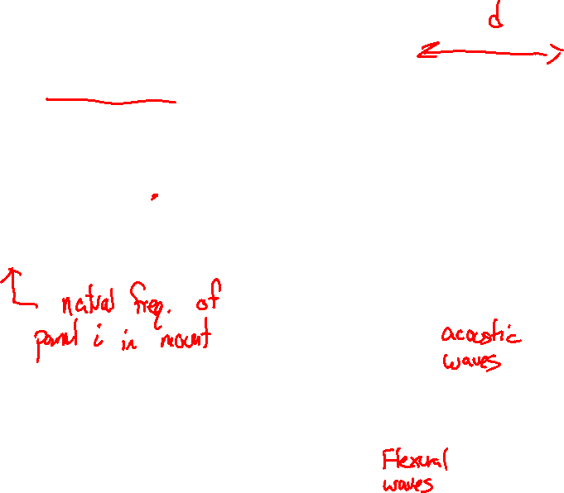
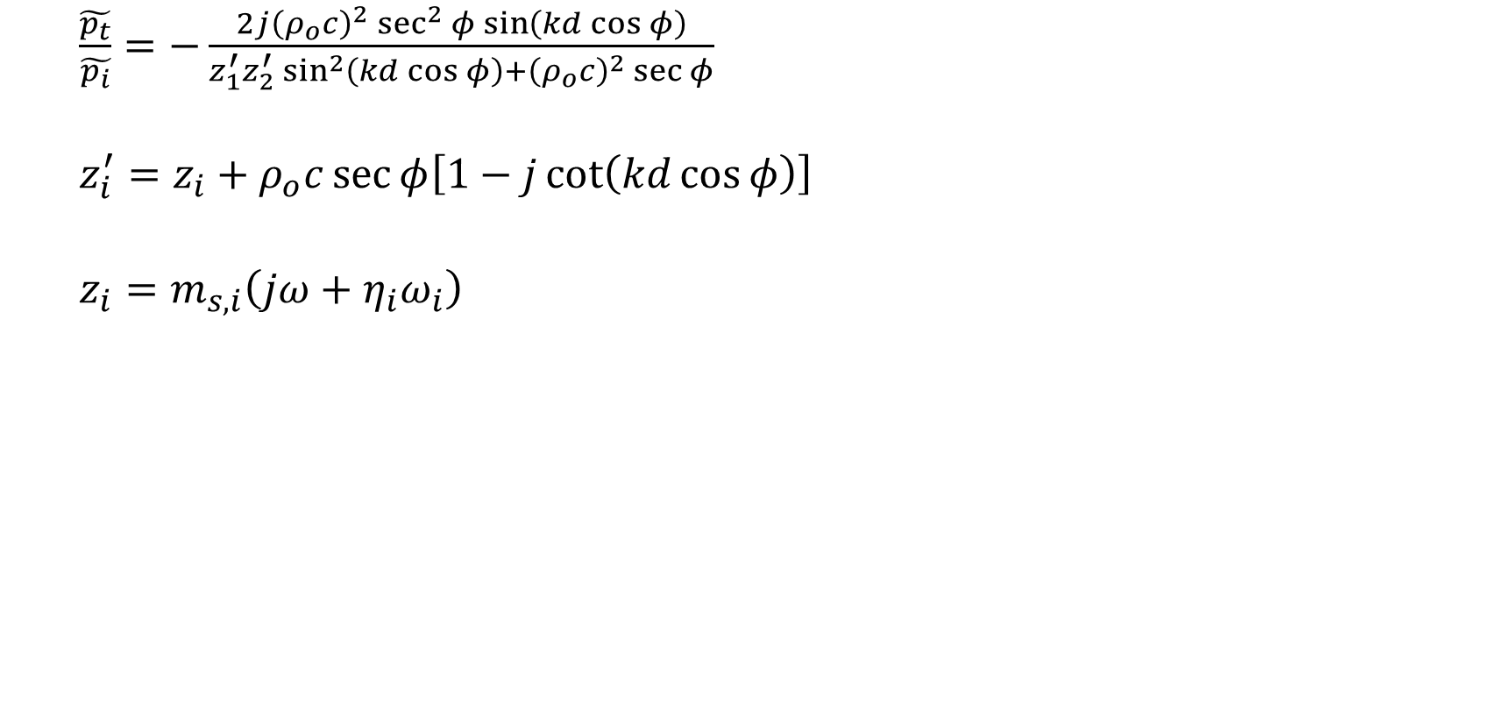
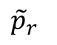
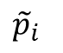
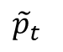
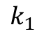
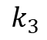
Multi-layer panels
$$z_{1}$$
$$z_{2}$$
$\frac{\tilde{p_{t}}}{\tilde{p_{i}}}=−\frac{2j{\left(ρ_{o}c\right)}^{2}\sec^{2}{φ}\sin\left(kd\cos{φ}\right)}{z_{1}^{′}z_{2}^{′}\sin^{2}\left(kd\cos{φ}\right)+{\left(ρ_{o}c\right)}^{2}\sec{φ}}$
$z_{i}^{′}=z_{i}+ρ_{o}c\sec{φ\left[1−j\cot\left(kd\cos{φ}\right)\right]}$
$z_{i}=m_{s,i}\left(jω+η_{i}ω_{i}\right)$
$$k_{1}$$
$${\tilde{p}}_{t}$$
$$k_{3}$$
$${\tilde{p}}_{r}$$
$$φ$$
$${\tilde{p}}_{i}$$

Slide 5
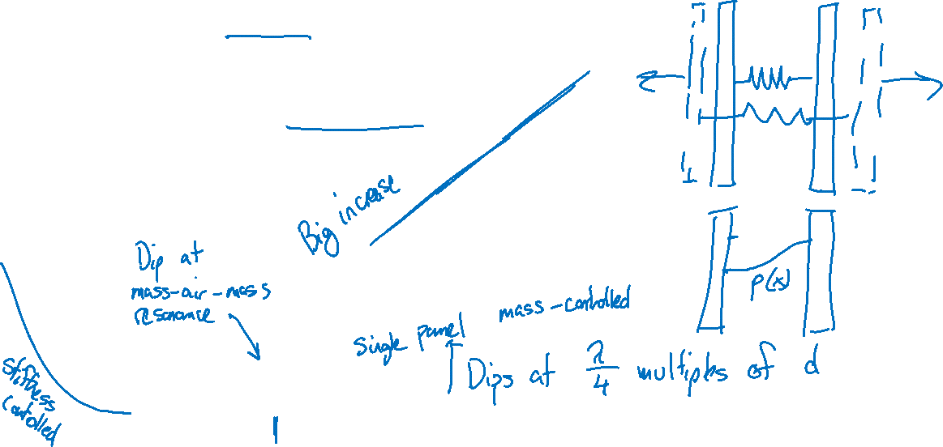
Multi-layer panels (normal incidence)

Slide 6
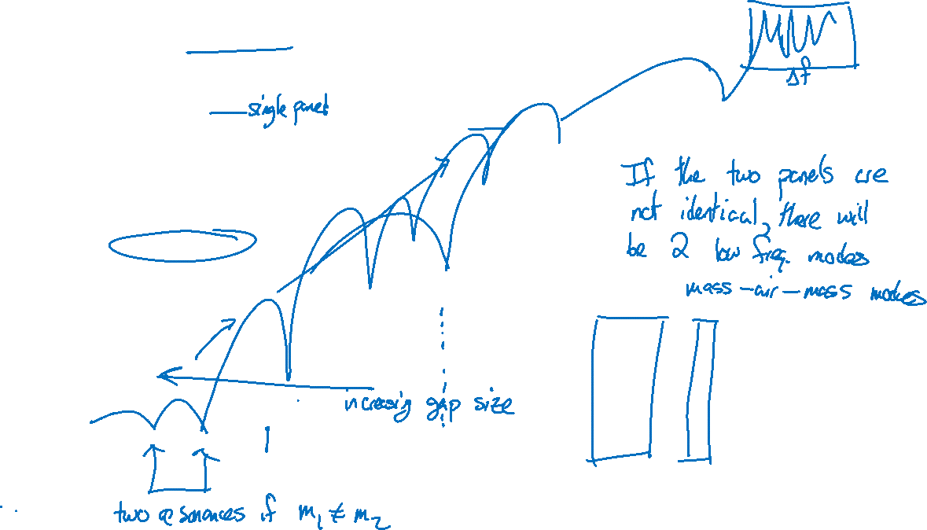
Multi-layer panels (normal incidence)

Slide 7
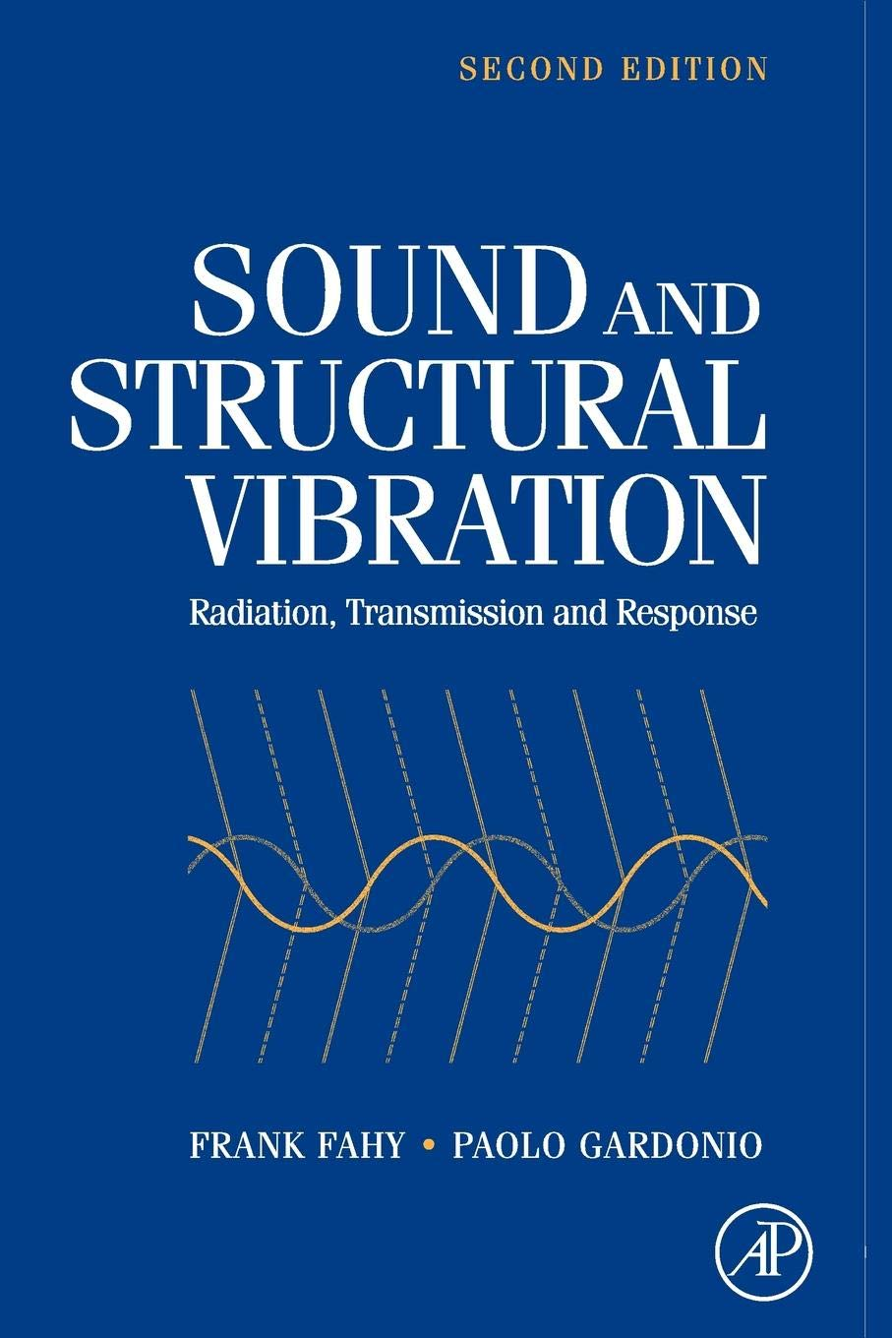
Multi-layer panels (random incidence)
“…the complexity of construction and correspondingly larger number of parameters, some of which are difficult to evaluate, militate against the refinement of theoretical treatments….
The following analyses are offered, therefore, more as vehicles for the discussion of the general physical mechanisms involved, than as means of accurate quantitative assessments of the performance of practical structures.”

Slide 8
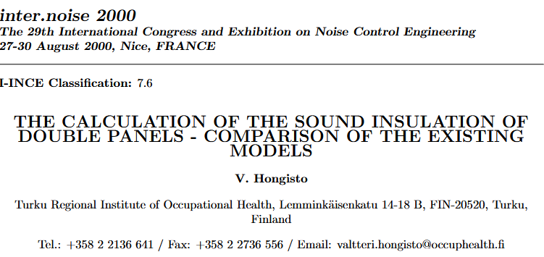
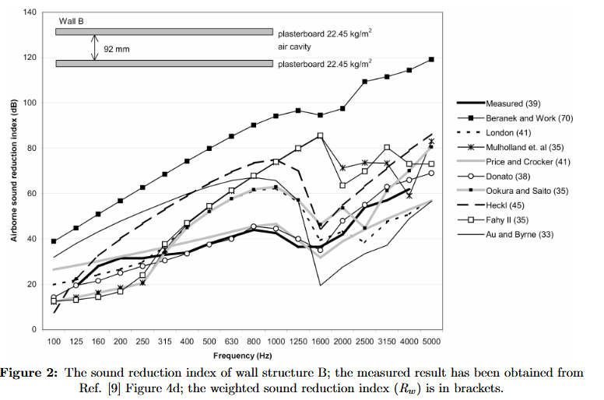
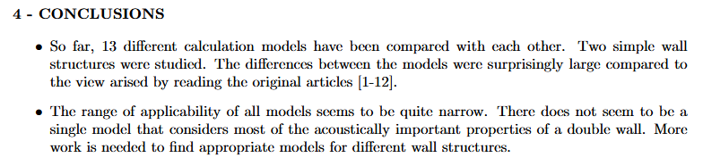
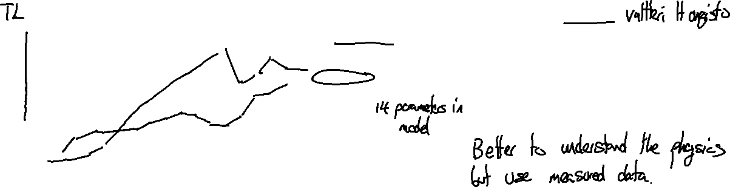
Multi-layer panels (random incidence)

Slide 9
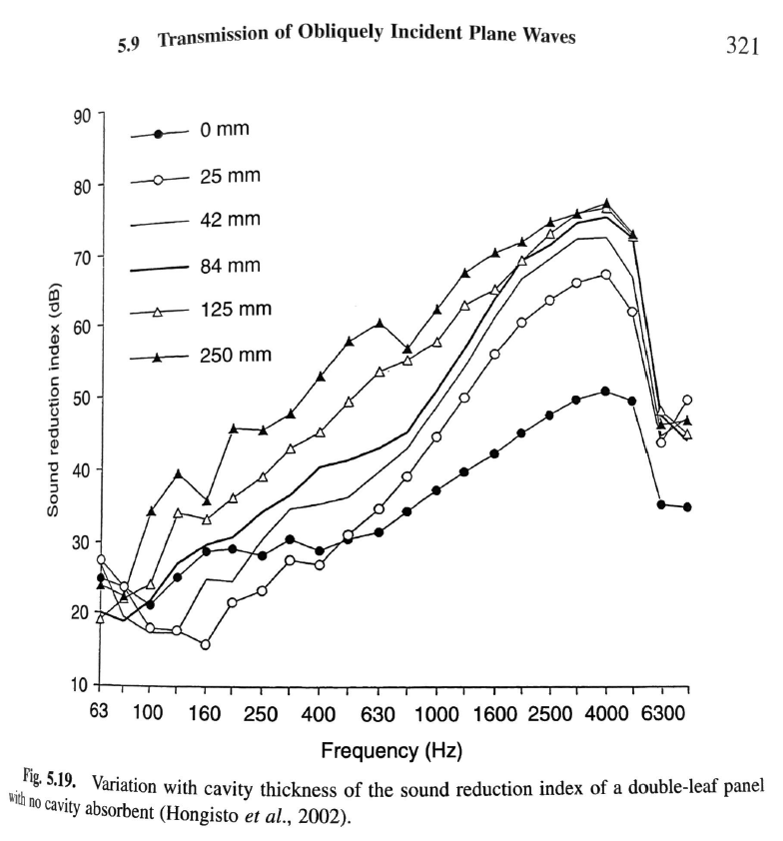
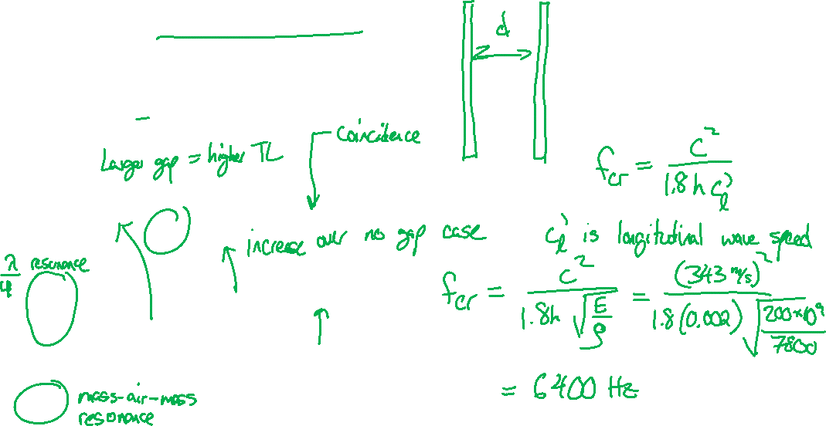
Multi-layer panels (random incidence)
2 mm steel panels
From Fahy & Gardonio

Slide 10
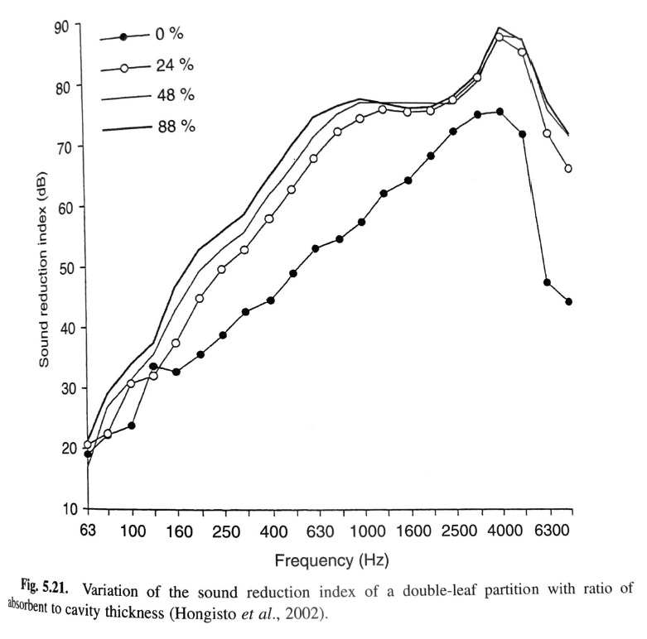
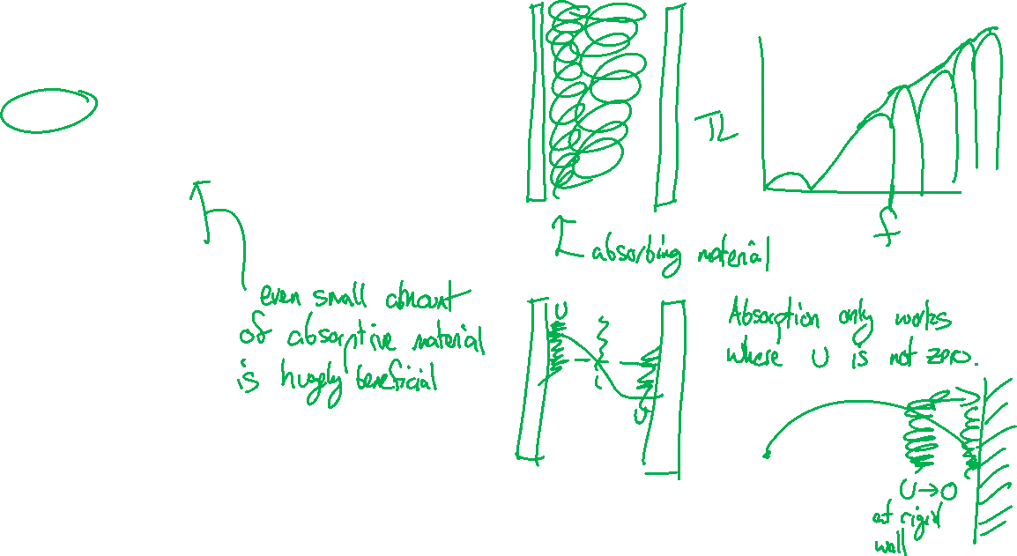
Multi-layer panels (random incidence)
2 mm steel panels with absorptive material in gap
From Fahy & Gardonio

Slide 11
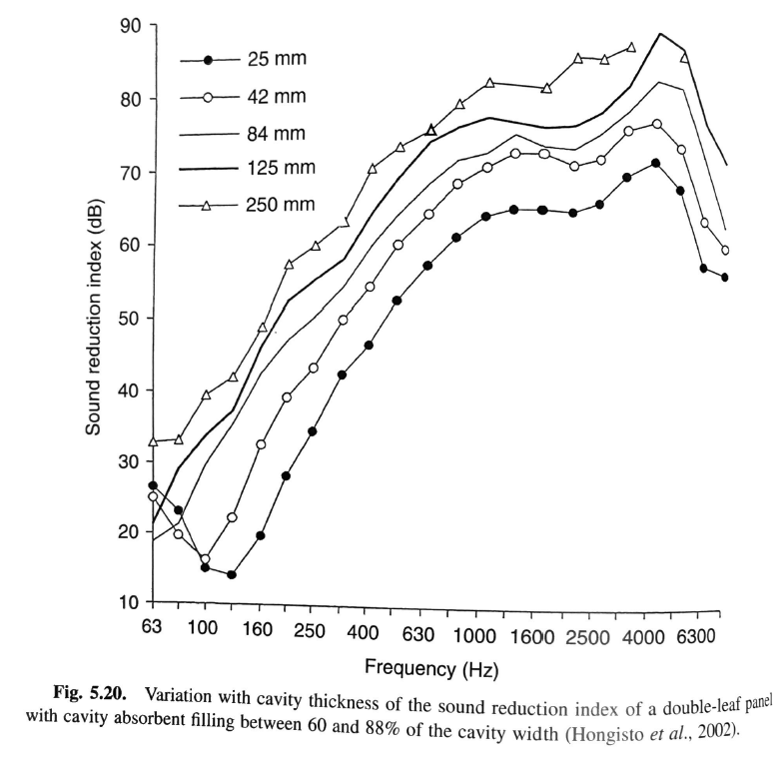
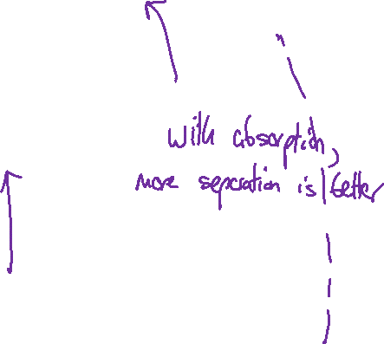
Multi-layer panels (random incidence)
2 mm steel panels with absorptive material in gap
From Fahy & Gardonio

Slide 12
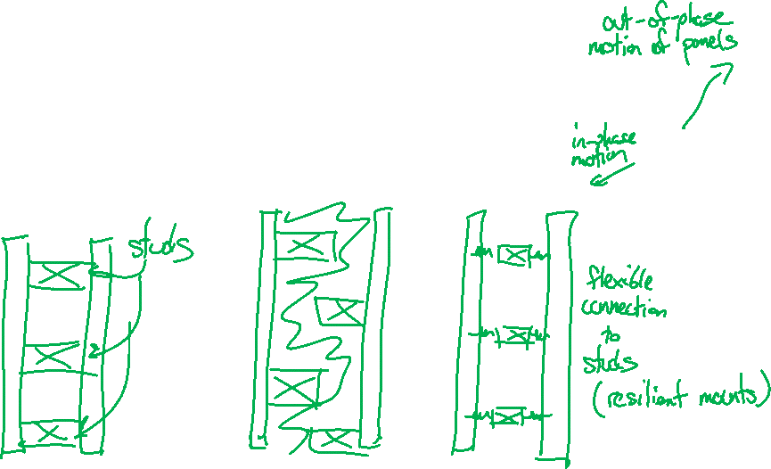
Multi-layer panels
Double-leaf panels rely on the out-of-phase motion of the panels to reduce transmission.
Wall studs prevent independent motion of the two panels, making them effectively a thick single panel.
Staggered studs keeps the two panels independent.

Slide 13
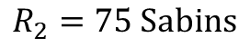
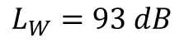
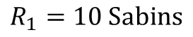
Example problem: partition design
You have one room with a loud piece of equipment in one corner. You plan to separate the single room into two rooms with a barrier wall. Specify a wall construction so that the SPL in the receiver room at 500 Hz is 50 dB.
3 m
6 m
$$R_{1}=10 Sabins$$
3 m high
4 m
$$L_{W}=93 dB$$
$$R_{2}=75 Sabins$$

Slide 14
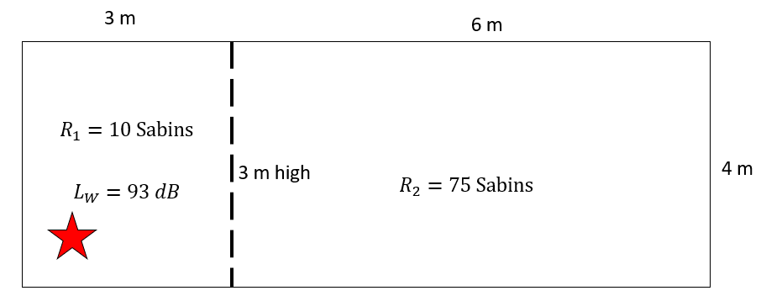
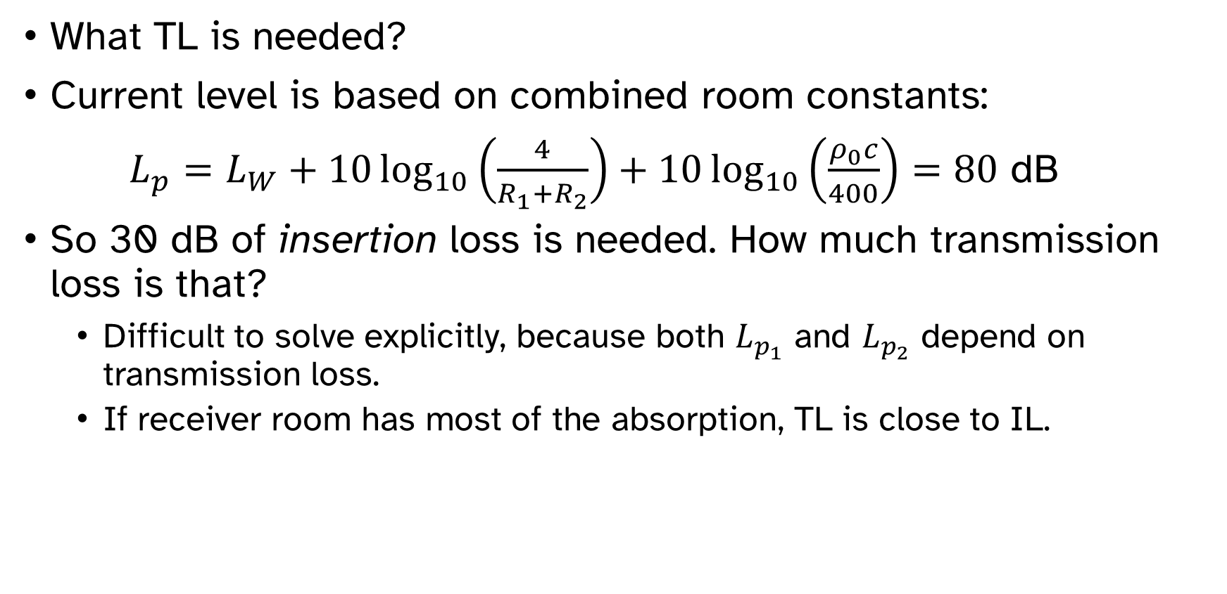
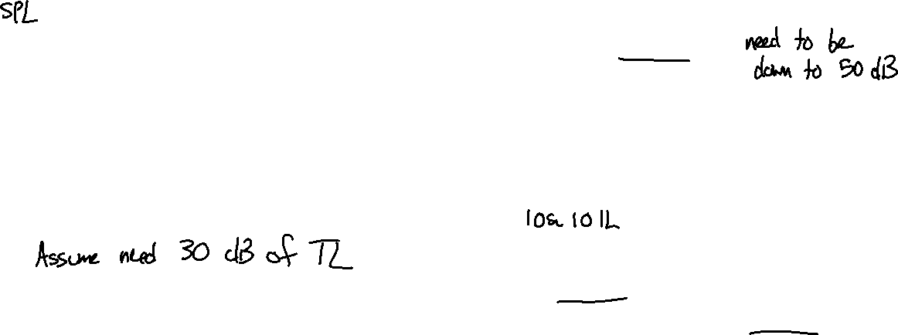
Example problem: partition design
What TL is needed?
Current level is based on combined room constants:
$L_{p}=L_{W}+10\log_{10}\left(\frac{4}{R_{1}+R_{2}}\right)+10\log_{10}\left(\frac{ρ_{0}c}{400}\right)=80$ dB
So 30 dB of insertion loss is needed. How much transmission loss is that?
Difficult to solve explicitly, because both $L_{p_{1}}$ and $L_{p_{2}}$ depend on transmission loss.
If receiver room has most of the absorption, TL is close to IL.

Slide 15
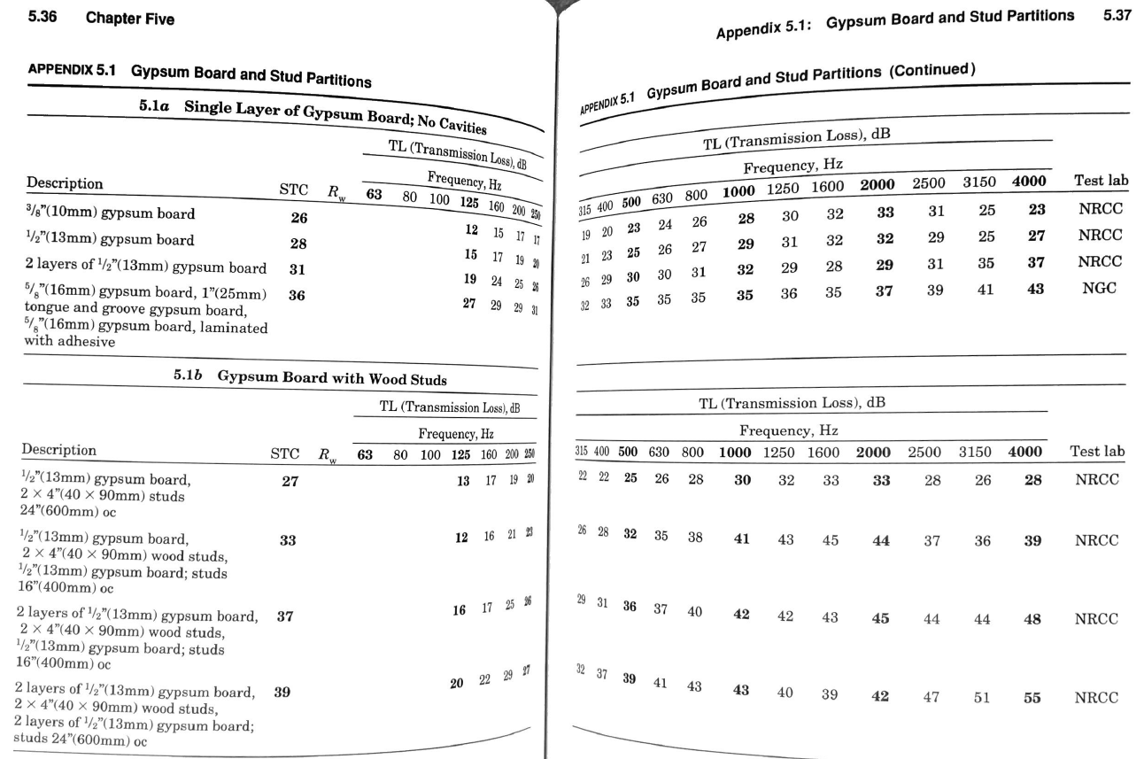
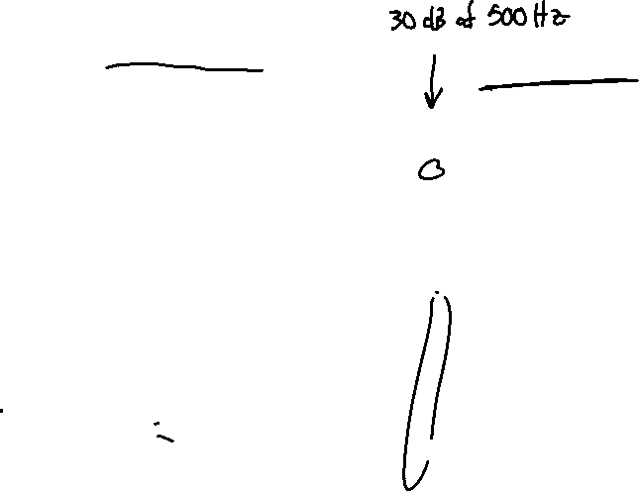
Example problem: partition design
Design Select a panel with 30 dB insertion loss at 500 Hz.

Slide 16
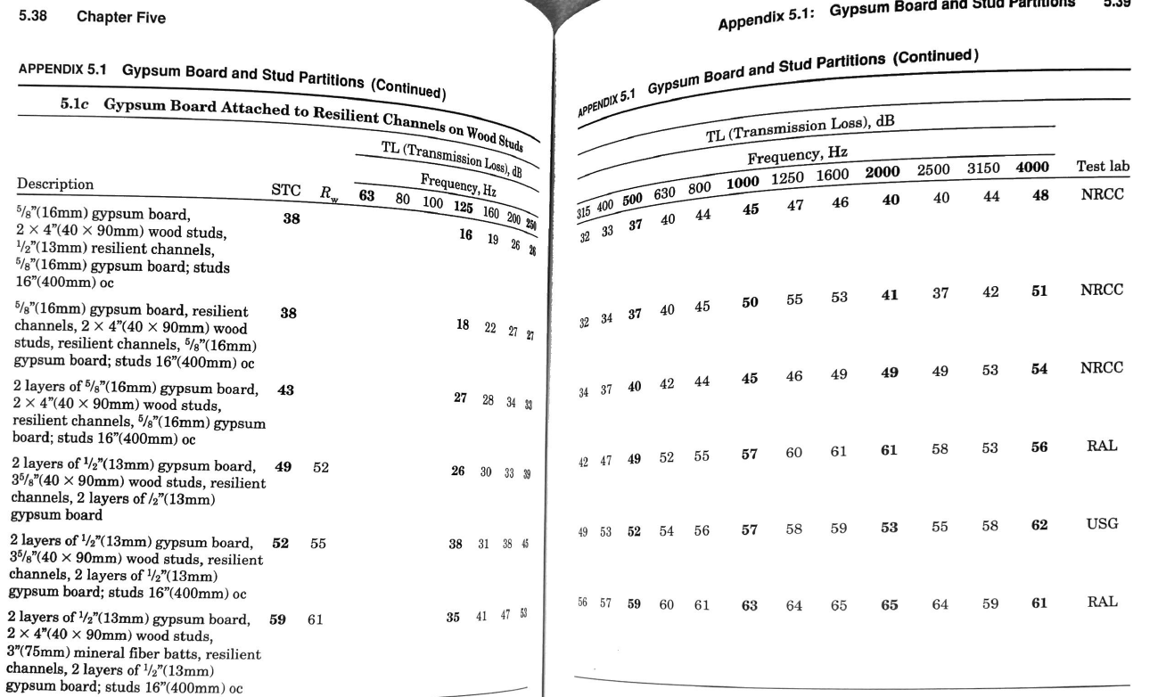
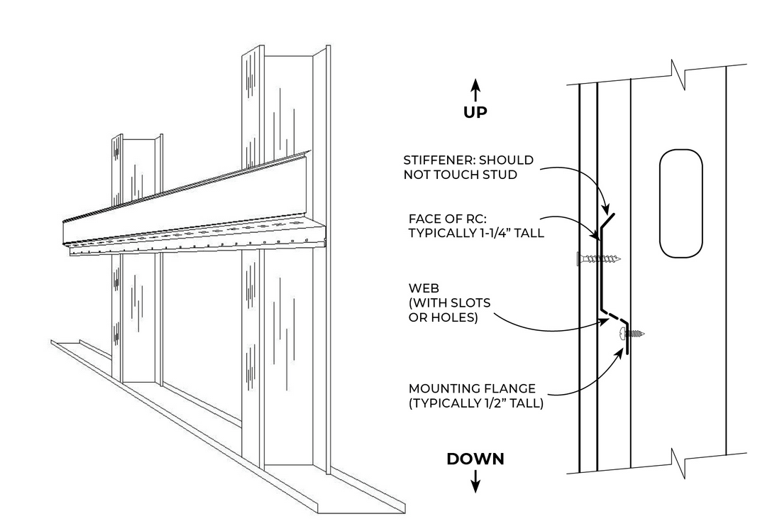
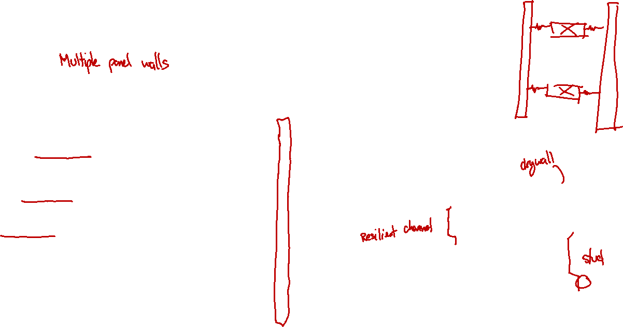
Example problem: partition design
Design Select a panel with 30 dB insertion loss at 500 Hz.

Slide 17
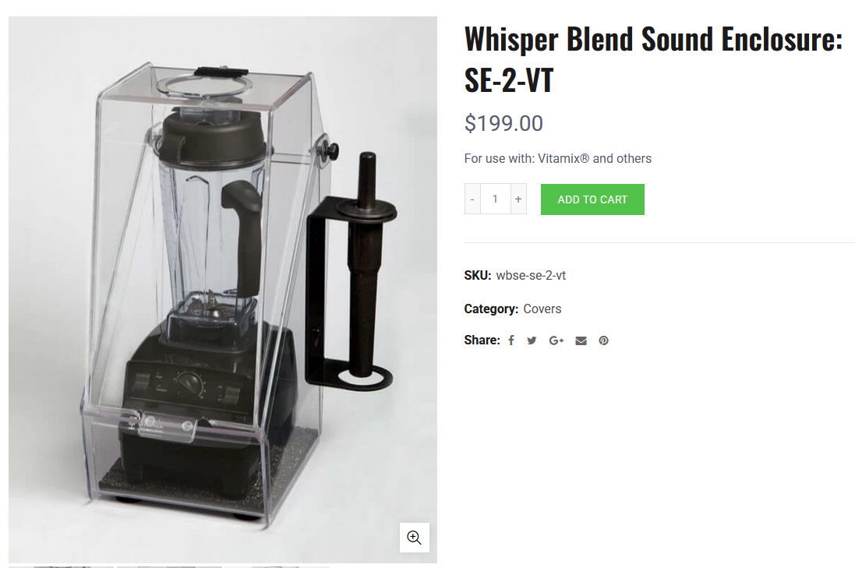
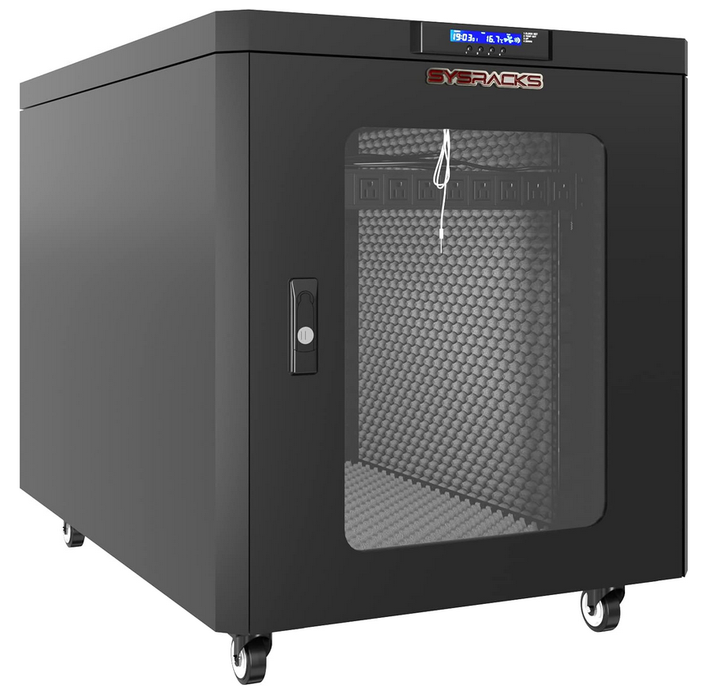
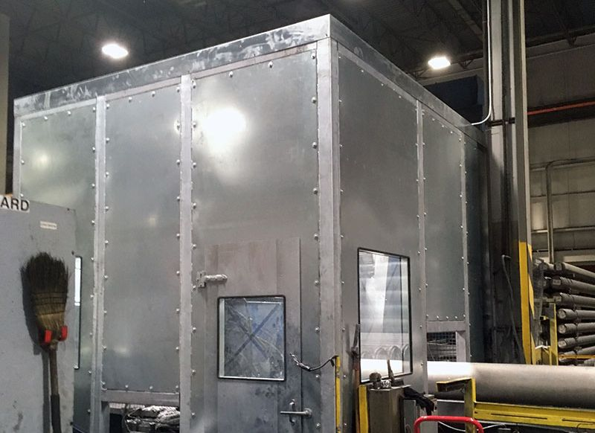
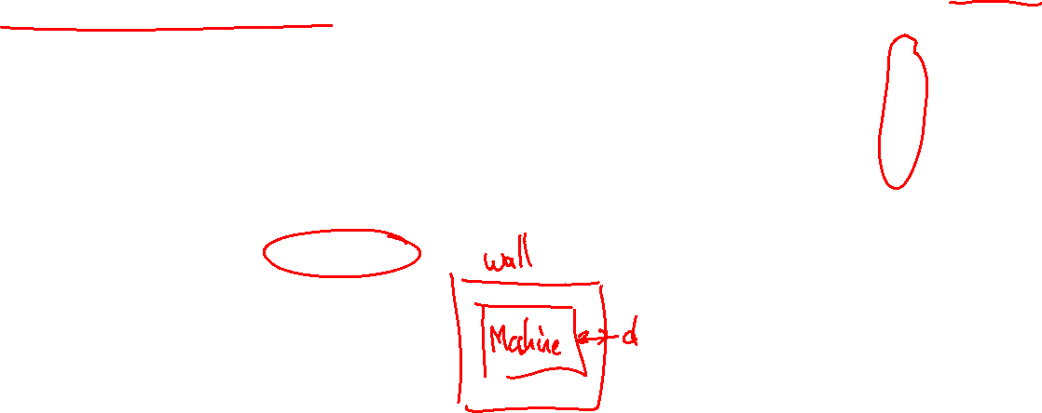
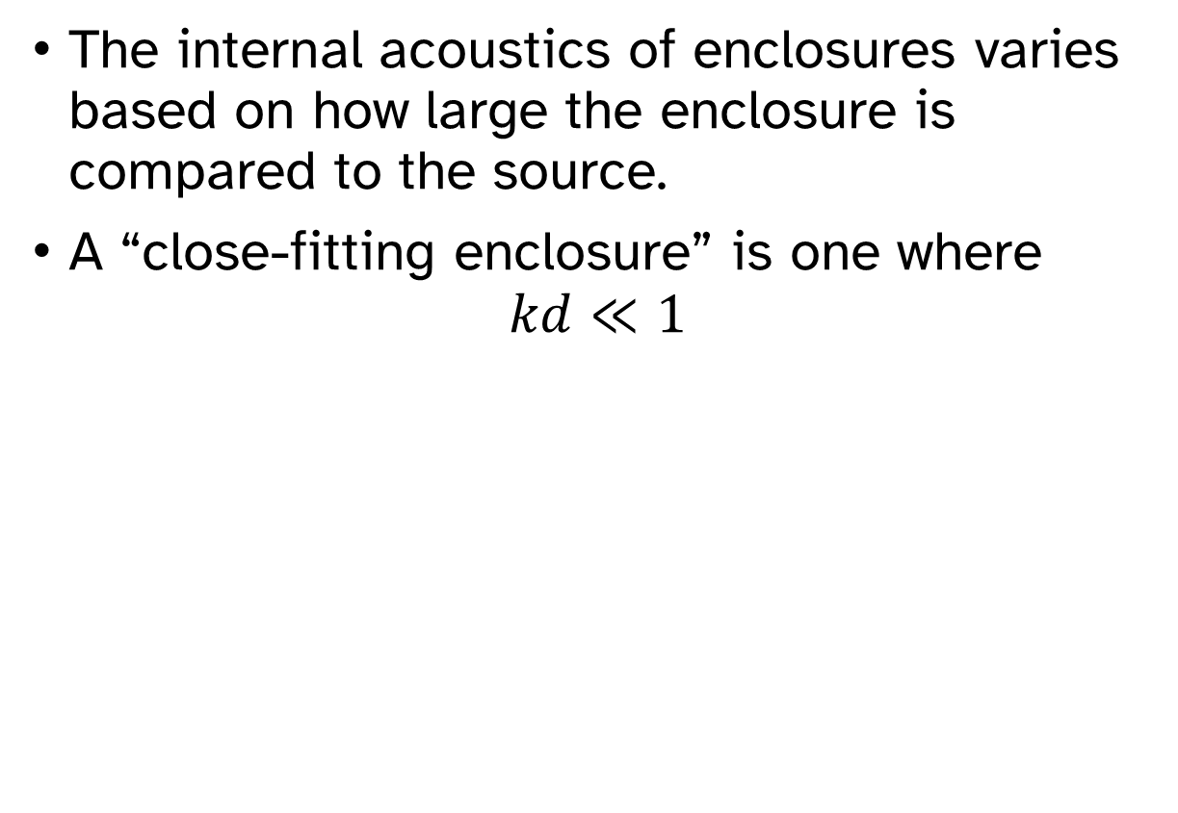
Close-fitting enclosures
The internal acoustics of enclosures varies based on how large the enclosure is compared to the source.
A “close-fitting enclosure” is one where
$$kd≪1$$

Slide 18
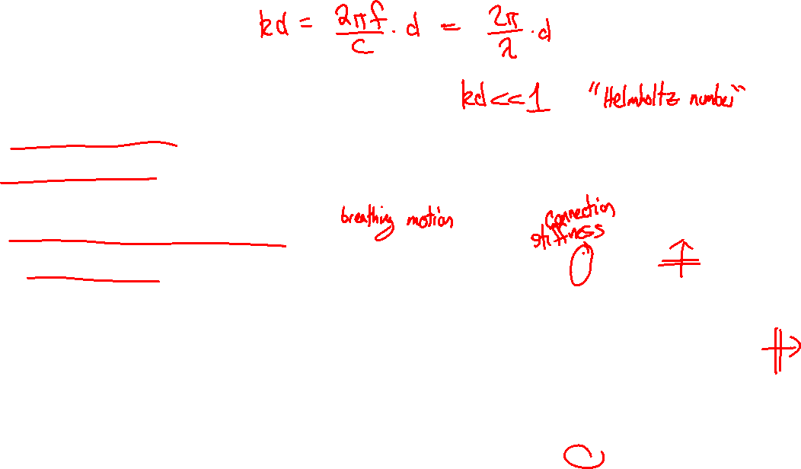
Close-fitting enclosures
Assumptions for close-fitting enclosures:
Normal incidence of waves on panel
Panel flexibility not important
Fundamental room mode is the dominant response
Absorption in air cavity is low
Damping is via wall mounting
Sound source

Slide 19
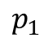
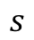
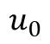
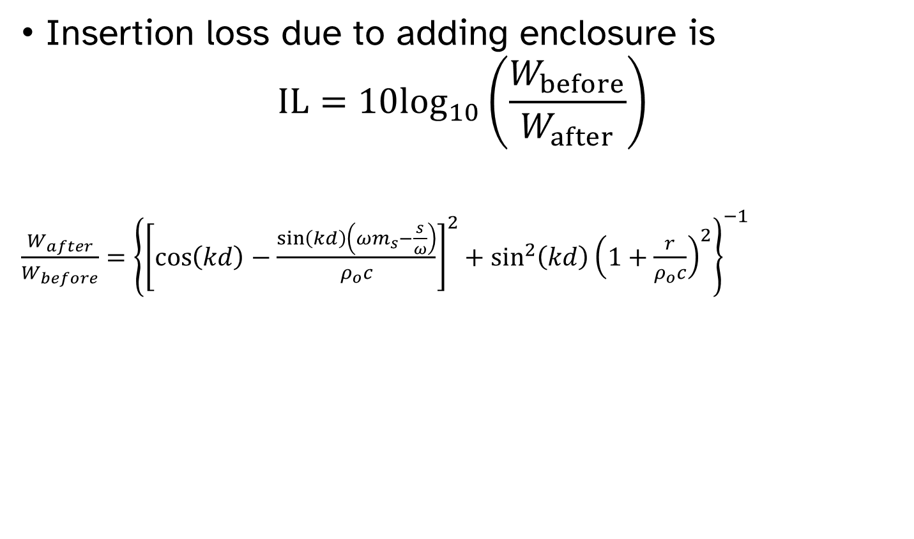
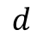
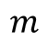


Close-fitting enclosures
$$s$$
Sound Source
Insertion loss due to adding enclosure is
$$IL=10\log_{10}\left(\frac{W_{before}}{W_{after}}\right)$$
$\frac{W_{after}}{W_{before}}={\left\{{\left[\cos\left(kd\right)−\frac{\sin\left(kd\right)\left(ωm_{s}−\frac{s}{ω}\right)}{ρ_{o}c}\right]}^{2}+\sin^{2}\left(kd\right){\left(1+\frac{r}{ρ_{o}c}\right)}^{2}\right\}}^{−1}$
$$r$$
$$m$$
$$u_{0}$$
$$p_{1}$$
$$d$$

Slide 20


Close-fitting enclosures
Close-fitting enclosures have the same mass, stiffness, and damping-controlled regions as infinite, rigid panels.

Slide 21


Close-fitting enclosures
“Theoretical predictions of the performance of such enclosures have not been conspicuously successful to date, and designers still rely heavily on empirical data.” – Fahy and Gardonio
Close-fitting enclosures require design for three frequency ranges:
Low frequencies
Stiffness-controlled, below mount resonance
Mid frequencies
Damping-controlled, near mount resonance and into the mass-controlled region
High frequencies
$kd>1$ so close-fitting model does not apply

Slide 22



Close-fitting enclosures—low frequencies
Insertion loss below resonance is given by
${IL}_{low}=20\log_{10}\left[1+\frac{C_{a}}{\sum_{i}{C_{wi}}}\right]$
$C_{wi}≈\frac{{10}^{−3}A_{wi}^{3}F\left(α\right)}{B_{i}}$ is the compliance of the $i^{th}$ wall
$C_{a}=\frac{V_{0}}{ρ_{o}c^{2}}$ is the compliance of the air
$A_{wi}=$ surface area of the $ith$ wall
$B_{i}=$ bending stiffness of the $ith$ wall $=\frac{Eh^{3}}{12\left(1−ν^{2}\right)}$
$F\left(α\right)=$ correction function for clamped or simply-supported walls
$α=$ ratio of length of longer wall dimension to shorter wall dimension
$V_{0}$ is the volume of air inside the enclosure (total volume minus machine volume)

Slide 23



Close-fitting enclosures—low frequencies
$C_{wi}≈\frac{{10}^{−3}A_{wi}^{3}F\left(α\right)}{B_{i}}$ is the compliance of the $i^{th}$ wall
$α=$ ratio of length of longer wall dimension to shorter wall dimension

Slide 24

Close-fitting enclosures—mid frequencies
At mid frequencies,
Increase damping of panels to minimize the insertion loss dip

Slide 25


Close-fitting enclosures—high frequencies
At high frequencies,
Waves at oblique incidence are possible
Coincidence dips can occur
Add absorptive material in inner surfaces
Tuning resonance:
Interior absorption is more effective at higher frequencies, so stiff, light panels can help as long as the critical frequency is above the frequency range of interest.
$$f_{cr}=\frac{c^{2}}{1.8hc_{l}^{′}}=\frac{c^{2}}{1.8h\sqrt{\frac{E}{ρ}}}$$

Slide 26




Large enclosures
Large enclosures$(kd≫1)$ can be treated similar to Sabine rooms separated by walls.
Insertion loss depends on both the absorption and the transmission loss. Need both to be high for the enclosure to be effective.
$$IL_{large}=10\log_{10}\left[1+\frac{S_{w}α_{w}+S_{i}α_{i}}{S_{w}+S_{i}} {10}^{\left({TL}/{10}\right)}\right]$$
$$kd≫1$$
$TL=$Transmission loss of the enclosure walls
$S_{w}=$ Interior surface area of the enclosure walls
$α_{w}=$ Absorption coefficient of interior wall treatments
$S_{i}=$ Surface area of the sound source
$α_{i}=$ Absorption coefficient of the source surface

Slide 27



$$IL_{large}=10\log_{10}\left[1+\frac{S_{w}α_{w}+S_{i}α_{i}}{S_{w}+S_{i}} {10}^{\left({TL}/{10}\right)}\right]$$

Slide 28




Use $α=0.99$ when reported values are greater than 1.

Slide 29




Leaks and ventilation holes reduce IL at low frequencies
Insertion loss of a leaky small enclosure is
$IL_{leaky}=20\log_{10}{\frac{C_{l}+C_{a}+\sum_{i}{C_{wi}}}{C_{l}+\sum_{i}{C_{wi}}}}$
Compliance of the leak is
$C_{l}=\frac{{\left(πa_{l}^{2}\right)}^{2}}{−ωρ_{o}\left(h+1.2a_{l}\right)πa_{l}^{2}+jωR_{a}}$
$a_{l}=$ radius of circular leak
$h=$ wall thickness
$R_{a}$ is resistance of hole
$$R_{a}=ρ_{o}\left[\sqrt{8νω}\left(1+\frac{h}{2a_{l}}\right)+\frac{{\left(2ωa_{l}\right)}^{2}}{16c}\right]$$

Slide 30


Leaks and ventilation holes reduce IL at low frequencies
For large enclosures, the degradation in IL due to leaks can be estimated by:
$$Δ{IL}_{l}={IL}_{sealed}−{IL}_{leaky}≈10\log_{10}\left(1+β×{10}^{\left({{TL}_{wall}}/{10}\right)}\right)$$
$β$ is the fraction of area of the wall that is a hole

Slide 31

Leaks and ventilation holes reduce IL at low frequencies
Sealing leaks is crucial if high insertion losses are required.

Slide 32


Slide 33


